Slide 1
LOW-LEVEL DESIGN
System Design(SD)(22CS024)
Bachelor of Engineering- Computer Science & Engineering
Department of Computer Science & Engineering
Chitkara University Institute of Engineering and Technology, Chitkara University, Punjab, India

Slide 2
Design Approaches in Software Engineering
Design approaches define how a software system is structured and built from specifications or requirements. They guide the transition from user needs to working code and typically include two main stages:
High-Level Design (HLD) – Architectural design, focusing on the system's structure.
Low-Level Design (LLD) – Component-level design, focusing on internal logic and implementation details.

Slide 3
Cont…
Low-Level Design (LLD)
Low-Level Design dives into the details of each module defined in HLD. It explains how individual components will work internally.
Key Features:
Focuses on class design, method definitions, and business logic.
Specifies algorithms, data structures, and database schema.
Guides developers in the actual coding process.

Slide 4
Core Components of LLD
Class Diagrams: Define the classes, their attributes, methods, and relationships.
Sequence Diagrams: Illustrate the sequence of interactions between objects to perform specific tasks.
Data Flow Diagrams: Show how data moves through the system, highlighting inputs, processes, and outputs.
Database Schema: Specifies the structure of the database, including tables, columns, and relationships.
User Interface Design: Details the layout and interactions of the user interface elements .

Slide 5
Best Practices in LLD
Modular Design: Break down the system into small, independent components with specific functionalities.
SOLID Principles: Apply object-oriented design principles to ensure code is maintainable and scalable.
Design Patterns: Utilize proven solutions to common design problems to promote code reuse and consistency .
Separation of Concerns: Ensure that each module addresses a separate concern, promoting modularity and reducing complexity

Slide 6
Deliverables of LLD
Deliverables:
Class Diagrams
Sequence Diagrams
Pseudocode / Flowcharts
Database Table Definitions

Slide 7
Benefits of LLD
Clarity and Understanding: Provides a detailed and clear understanding of how the system will be implemented.
Efficiency: Ensures that the system is designed to be efficient, with optimized data structures and algorithms.
Modularity: Promotes modularity and reusability by breaking the system into smaller, manageable components.
Maintenance: Makes the system easier to maintain and modify in the future by providing a clear design structure.
Validation: Helps validate the design against the requirements, ensuring that the system will meet its intended purpose .

Slide 8
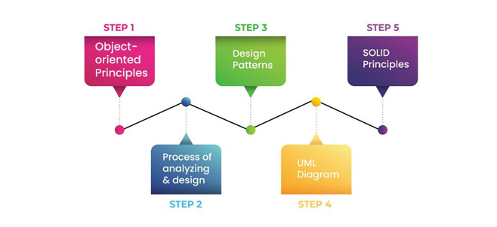
Procedure of Low Level Design

Slide 9
Procedure of Low Level Design cont…
Step 1. Understanding Object-Oriented Principles
The user requirement is processed by using concepts of OOPS programming. OOP concepts serve as the foundation for LLD, and having a deep understanding of them will help you design maintainable and scalable software components. Hence it is recommended to have a strong grip on Object-Oriented Programming principles such as:
Encapsulation: Bundling data and the methods that operate on that data within one unit.
Inheritance: Mechanism where a new class can inherit the properties and methods of an existing class.
Polymorphism: Ability of different classes to respond to the same method in different ways.
Abstraction: Hiding the complex implementation details while showing only the essential features of an object.

Slide 10
Procedure of Low Level Design cont…
Step 2. Analyzing and Designing Components
LLD requires you to analyze real-world problems and break them down into object-world problems using OOP concepts. This is a critical step where real-world entities are modeled into objects and classes.
You should focus on:
Identifying classes and objects based on the system requirements.
Determining relationships (like associations, inheritance, etc.) between different entities.
Using SOLID principles to ensure your design is clean, maintainable, and scalable.

Slide 11
Procedure of Low Level Design cont…
Step 3. Implementing Design Patterns
The implementation of our above object-oriented problem is carried out with the help of design patterns. Design patterns are reusable solutions to common problems encountered in software design.
They provide a structured approach to design by capturing best practices and proven solutions, making it easier to develop scalable, maintainable, and efficient software. By using these patterns, developers can solve problems more effectively while adhering to best practices.
Creational Patterns
Singleton: ensures only one instance of a class exists (e.g., database connection manager).
Factory Method: provides an interface for creating objects, letting subclasses decide which class to instantiate (e.g., different types of users in a system).
Behavioral Patterns (e.g., Observer, Strategy): Focus on communication between objects and how they interact with each other.
Structural Patterns (e.g., Adapter, Composite): These patterns are concerned with simplifying the structure of the system and its components.

Slide 12
Procedure of Low Level Design cont…
Step 4. Use of UML Diagram in LLD
Unified Modeling Language is a visual representation used to design and model the system. UML diagrams play an important role in converting HLD to LLD. They provide a proper and clear visual representation of the components and their relationships, which helps developers significantly.
Some of the most important UML diagrams used in LLD include:
Class Diagrams: Represent the structure of the system in terms of its classes and the relationships between them.
Sequence Diagrams: Illustrate how objects interact over time, showing the sequence of method calls.
Activity Diagrams: Show the workflow or activities of a system component.
State Diagrams: Represent the different states of a component or object and the transitions between these states.
Use Case Diagrams: Define the functional requirements of the system by showing different user interactions.

Slide 13
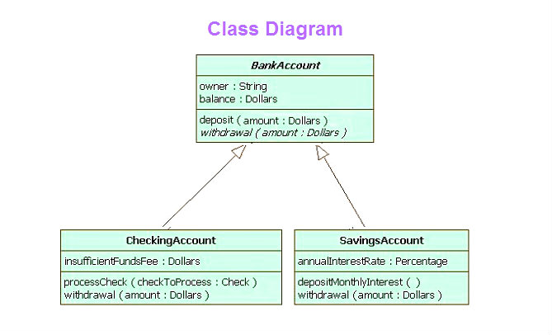
Procedure of Low Level Design cont…
Class Diagram:

Slide 14
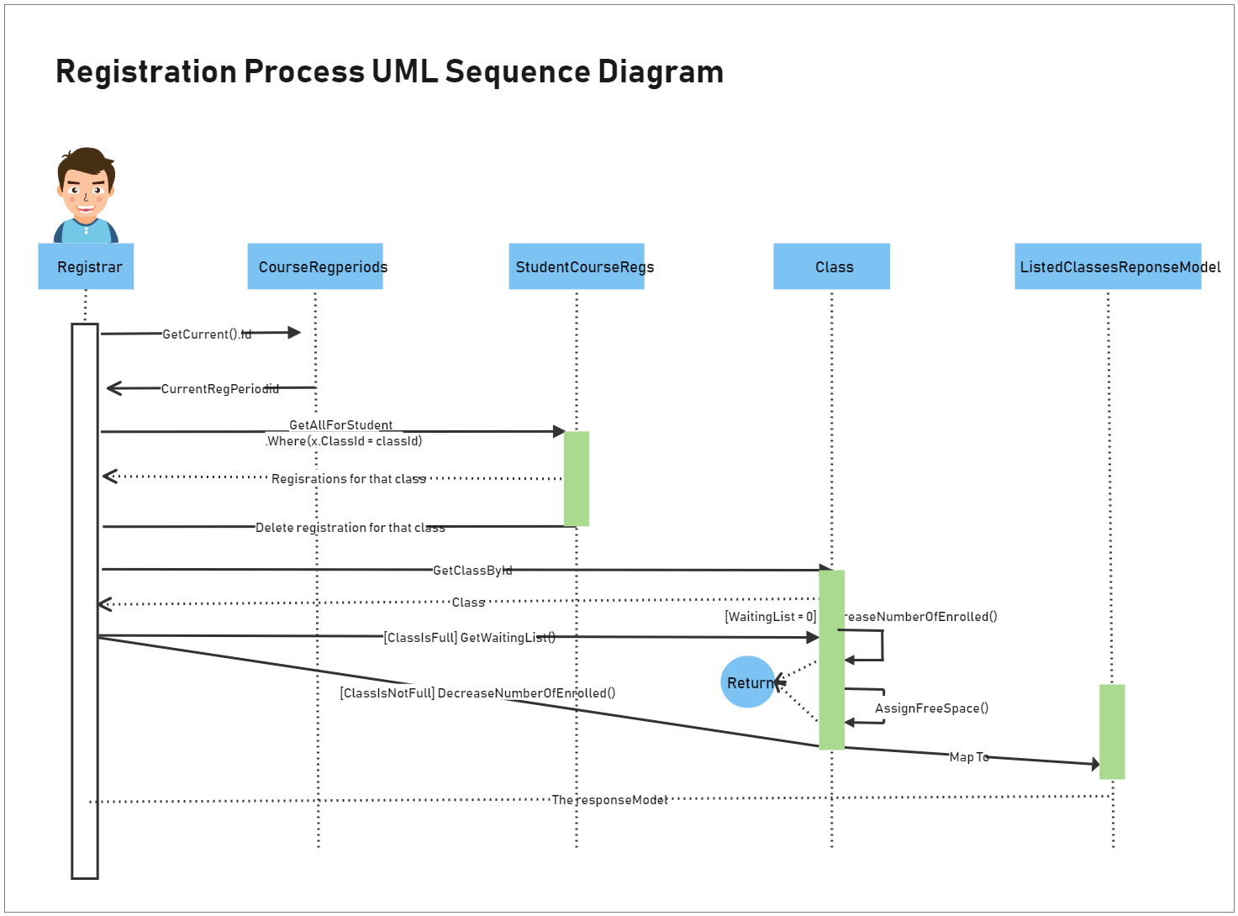
Procedure of Low Level Design cont…
Sequence Diagram:

Slide 15
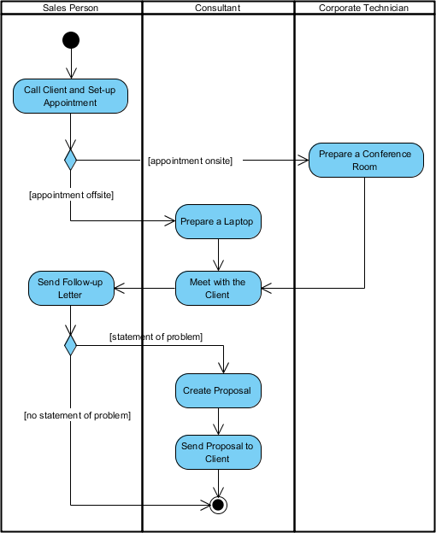
Procedure of Low Level Design cont…
Activity Diagram:

Slide 16
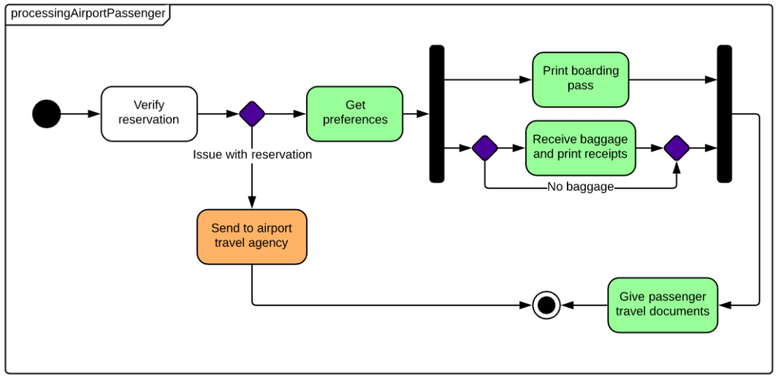
Procedure of Low Level Design cont…
State Diagram:

Slide 17
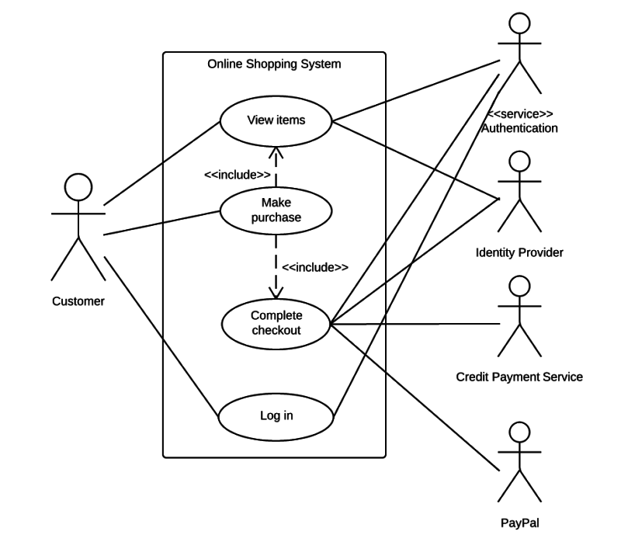
Procedure of Low Level Design cont…
Use Case Diagram:

Slide 18
Procedure of Low Level Design cont…
Step 5. Implementing SOLID Principles
These are sets of 5 principles(rules) that are strictly followed as per requirements of the system or requirements for optimal designing. In order to write scalable, flexible, maintainable, and reusable code:
Single-responsibility principle (SRP):A class should have a single responsibility
Open-closed principle (OCP):Classes should be open for extension, but closed for modification
Liskov’s Substitution Principle(LSP):If S is a subtype of T, then objects of type T in a program may be replaced with objects of type S without altering any of the desirable properties of that program.

Slide 19
Procedure of Low Level Design cont…
Interface Segregation Principle (ISP):Clients should not be forced to depend on methods that they do not use.
Dependency Inversion Principle (DIP):High-level modules should not depend on low-level modules. Both should depend on the abstraction.
Abstractions should not depend on details. Details should depend on abstractions.
It's important to keep in mind that SOLID principles are just guidelines and not strict rules to be followed.

Slide 20
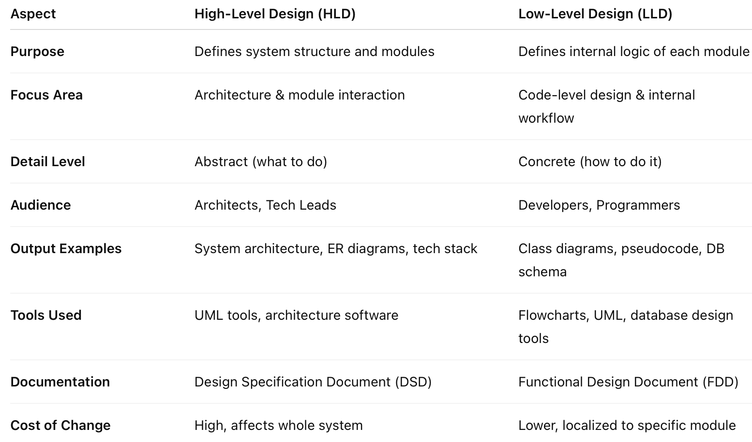
Comparison: High-Level Design vs Low-Level Design

Slide 21
THANK YOU

